Slide 1

Saving species: Turning understanding into action

Slide 2
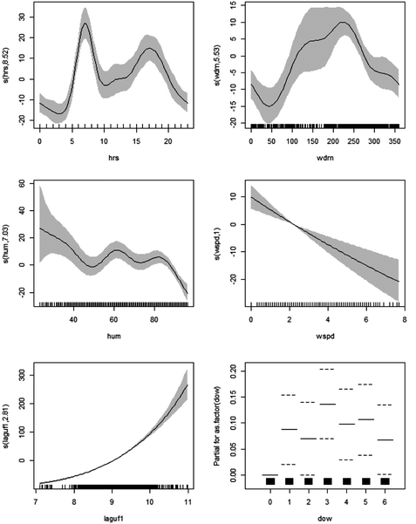
To save species you must know some stats

Slide 3
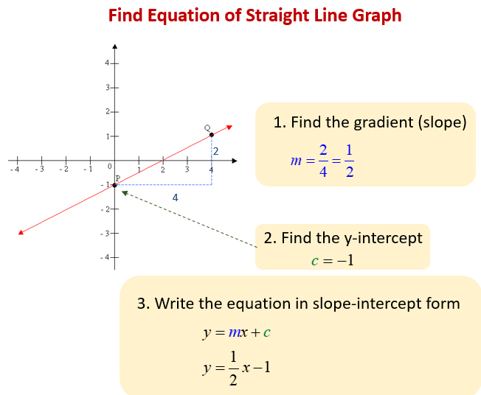
Stats: making the simple seem really complicated
High-school revision
Statistics is all about finding associations, e.g. when we increase temperature (x) what happens to weight (y)?
Almost all statistics in biology is some variation of: y = mx + c
The stats in this course are probably the furthest you will ever get from this formula.

Slide 4
Statistics and data
y = mx + c
Continuous (e.g. height)
Observed
Grouped
(e.g. eye colour)
Data
Unobserved
“Parameter”

Slide 5
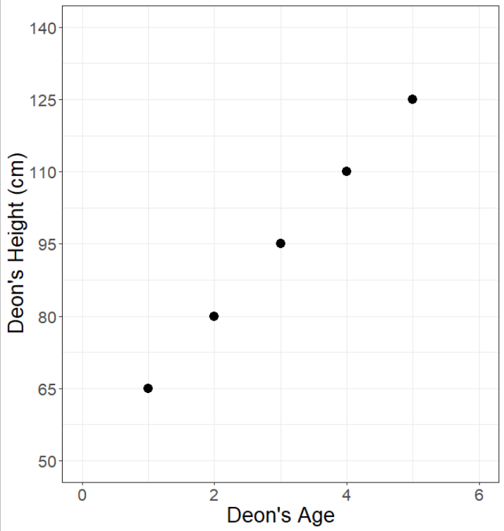
Doing statistics by hand
Remember your straight line equation:
y = mx + c
y = Deon’s height
x = Deon’s age
m = Slope (aging 1 year increased my height by m)
c = y-intercept (I was c tall when I was born)
Observed data
Unobserved data

Slide 6
Stats by hand
Deon’s Height = m * Deon’s Age + c
We measure height and age
Therefore they is observed
We do not measure m or c
Therefore they are unobserved
Any unobserved values (i.e. parameters) need to be estimated.
How tall was I when I was born (i.e. c)?
How much did I grow each year (i.e. m)?

Slide 7
Stats by hand
Deon’s Height = m * Deon’s Age + c
What is m?
80 cm – 65 cm = 15 cm grown in one year
m = 15 cm per year
What is c?
Draw a line down to 0 years old.
c = 50 cm at 0 years old
How tall was I at 6 years old?
Height = 15 (cm) * (6 years old) + 50 (cm) = 140 cm

Slide 8
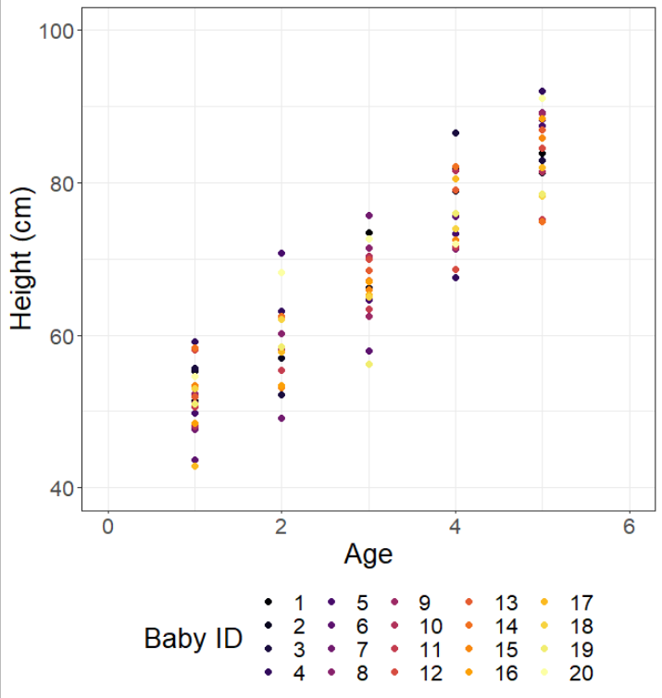
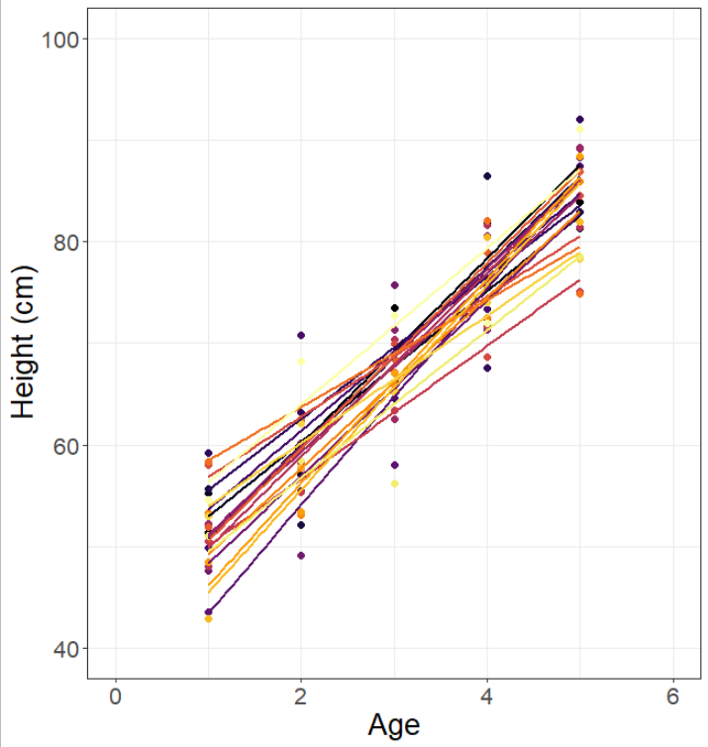
More realism
Statistics tries to find associations by estimating unobserved data using observed data.
What about when there is more than one baby?
Requires some way of ranking all the different possible parameter values for m and c.

Slide 9
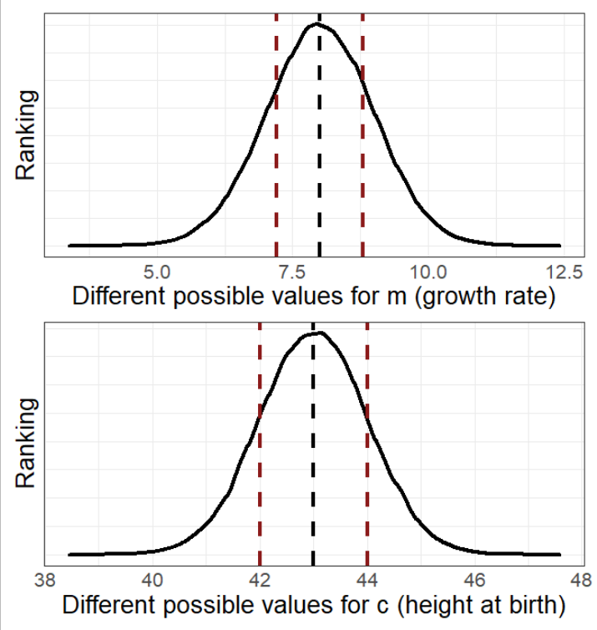
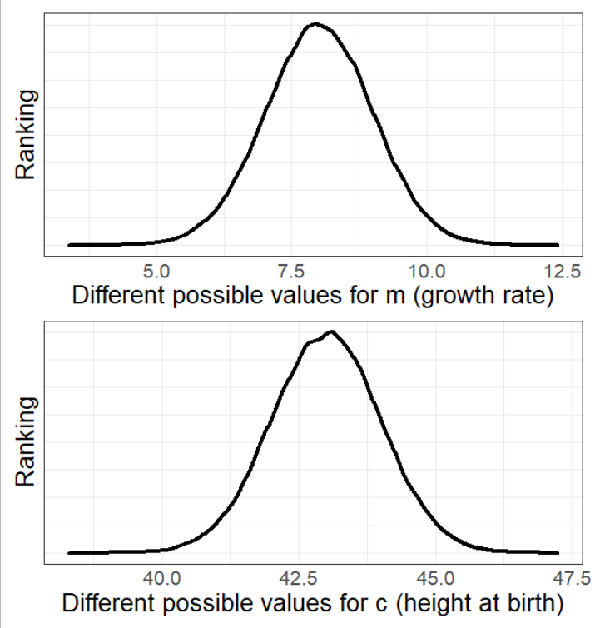
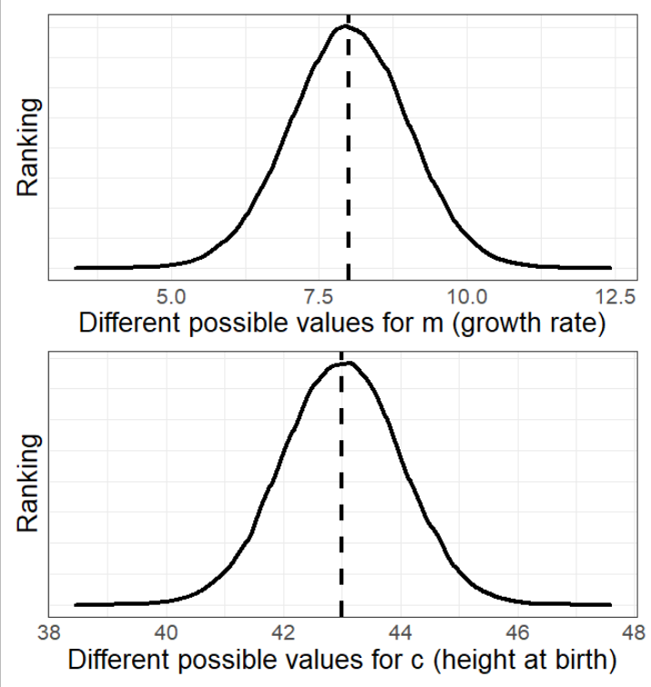
Maximum Likelihood Estimate - Briefly
The “algorithm” tries many different possible values for all parameters.
Each value is given a “rating”
The parameter values with the best ranking are those reported to you.
Along with the 95% confidence profiles.

Slide 10
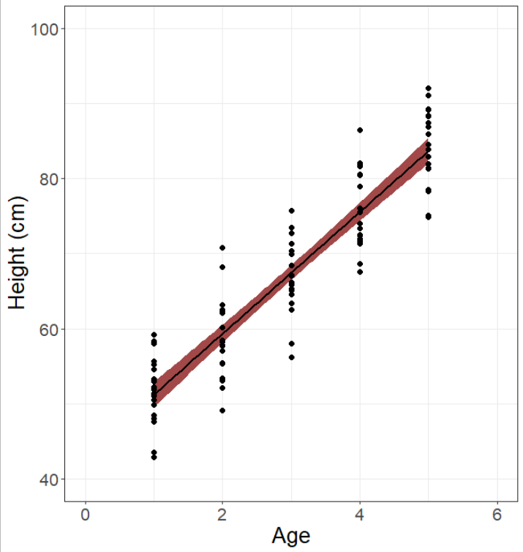
So what does MLE estimate?
From an infinite possible number of parameter values:
MLE tries a variety of values and reports how well they worked, giving:
c = 43.106 ± 1.164
m = 8.115 ± 0.351
So MLE does the heavy lifting. Our only job is to use it responsibly and with caution!

Slide 11

The Monkey’s Paw
The Monkey’s Paw is a short story from 1902 by W. W. Jacobs. A suitably middle-class family come into possession of a wish granting monkey paw, but every wish “backfires”.
Asking questions from statistical models is like asking for wishes from the monkey’s paw. Any poorly chosen wish will lead to dire consequences, so wishes must be tailored with great care.
Models are the same. Any slightly poorly written question will “always” give you an answer, even if it’s terrible. The real risk is that you might not know it’s terrible.

Slide 12
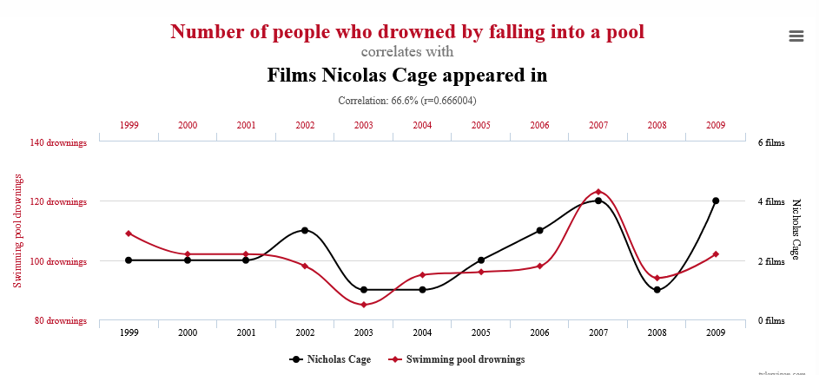
Beware the statistical Monkey’s Paw

Slide 13
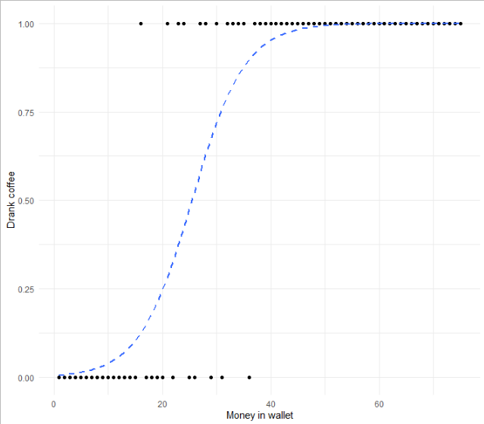
Think like a biologist, not like a statistician
How many of you drank coffee this morning?
A “statistician” would use any covariate and call it done.
Is the amount of money in your wallet all that determines if you had coffee this morning?

Slide 14
Think like a biologist, not like a statistician
How many of you drank coffee this morning?
Did your parents drink coffee when you were young?
Did you watch TV shows where “mature” characters drink coffee?
Did you want to emulate those characters?
Are you from a culture where drinking coffee in the morning is considered normal?
Did you drink tea?
Were you hungover?
Do you believe drinking coffee helps with hangovers?
Etc., etc.

Slide 15
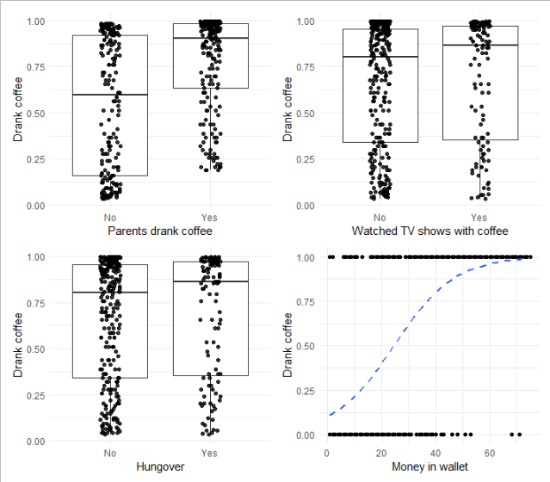
Everything in the world is generated by complex processes
A huge amount of information goes in to each thing that we may be interested in explaining.
We tend to simplify these down, not because we believe they are simple
But because knowing what might influence it and then gathering all that information is unfeasible
Do not fall into the view that every complex processes can be boiled down to y = mx + c or whatever variants (though some can).
The best models try to capture the most important features of a process.
Build a model that reflects your hypothesis!

Slide 16
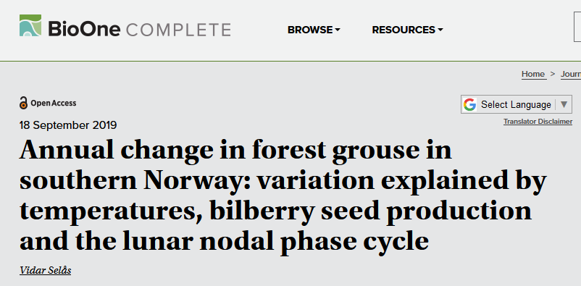
The Monkey’s Paw in actual science?

Slide 17
tl;dr
y = mx + c is the workhorse of statistics in biology
Data can be thought of as observed and unobserved
Unobserved data are called parameters and need to be estimated
Parameters are estimated using observed data
Maximum Likelihood Estimate (MLE) estimates the most likely parameter values
Importantly, these are only estimates, they are not the truth
Great care must be given to ensure that any data included is biologically feasible
No thought increases risk of spurious correlations

